Slide 1








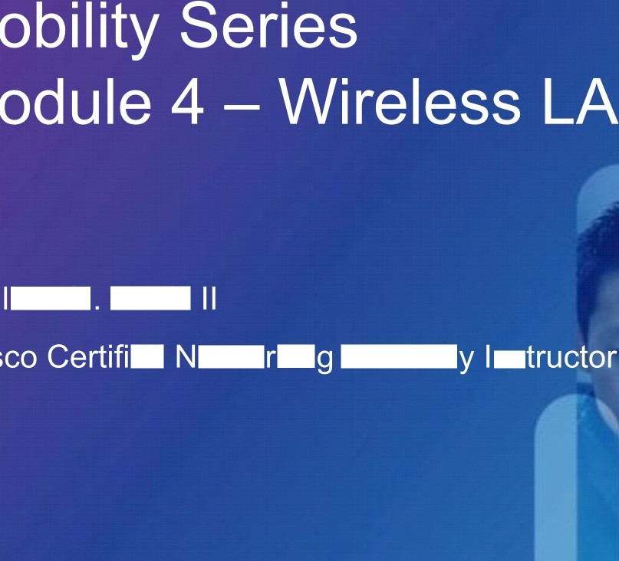












etworki
Acad
VindVVi de
Wolfe
ed etwo kin
Academ ns
Train

Slide 2
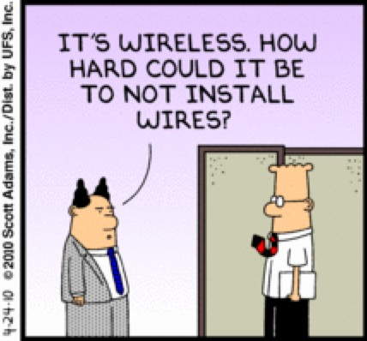
isco and/or its affiliates. All rights reserved.
Cisco Confidential

Slide 3

1.
Overview of WLAN Security
2.
Wireless Vulnerabilities and Threats
3.
Threat Mitigation Technologies
4.
Strong Authentication and Encryption
5.
Centralizing WLAN Authentication
6.
Conclusion/Remarks/Resources
isco and/or its affiliates. All rights reserved.
Cisco Confidential

Slide 4

isco and/or its affiliates. All rights reserved.
Cisco Confidential

Slide 5
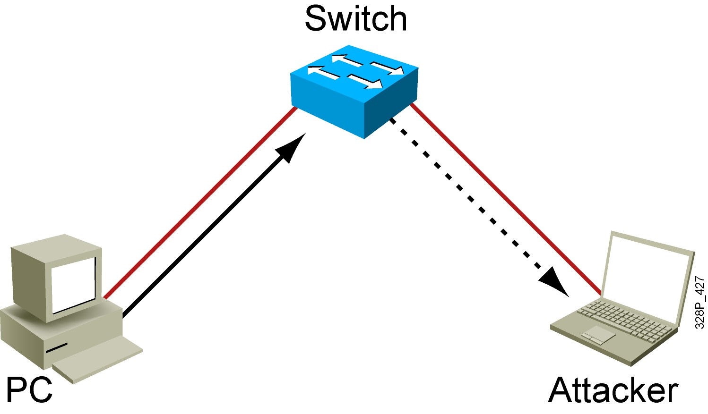
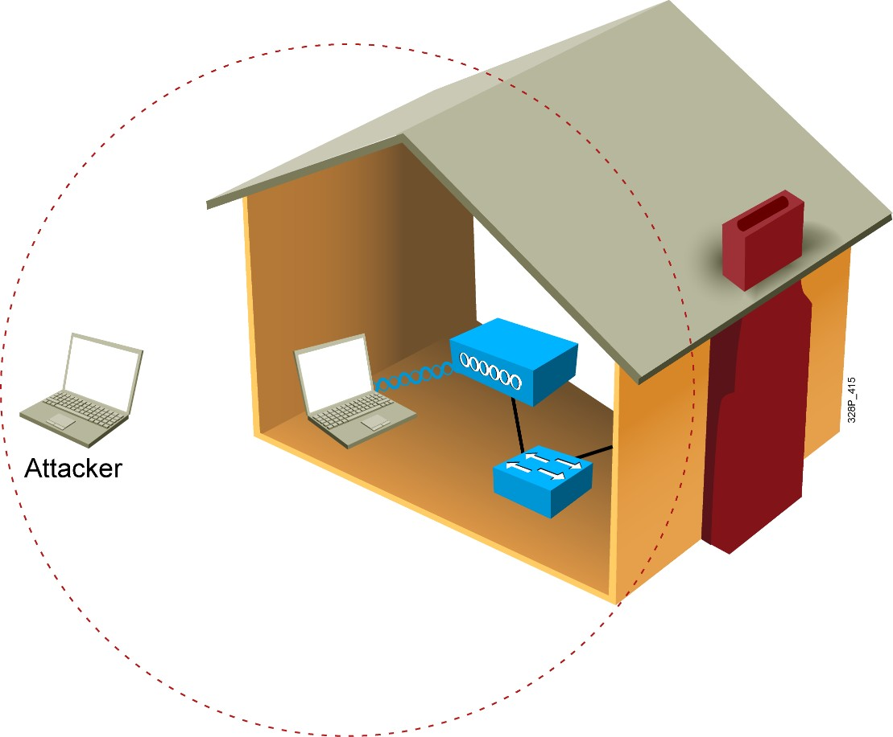
Wired vs. Wireless Privacy

Slide 6
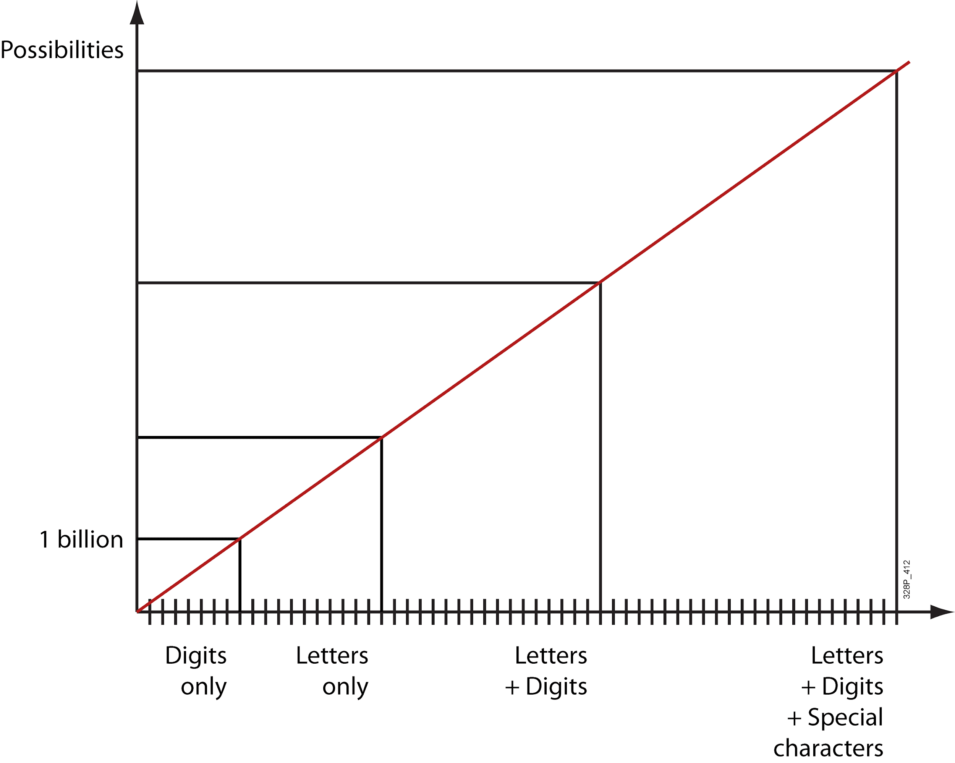
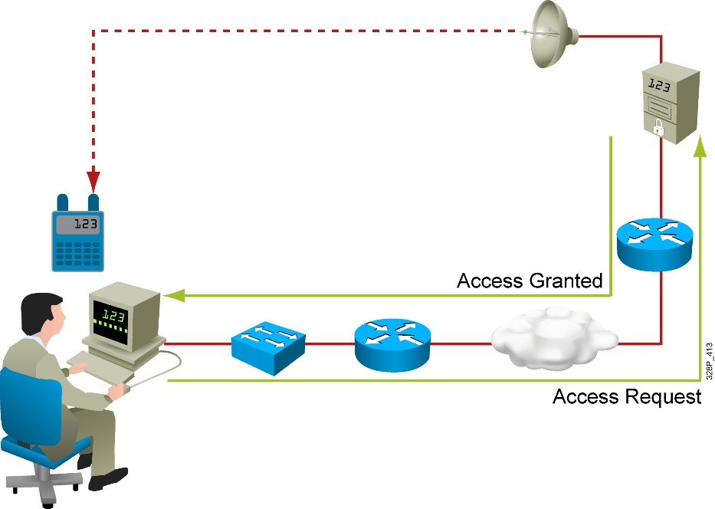
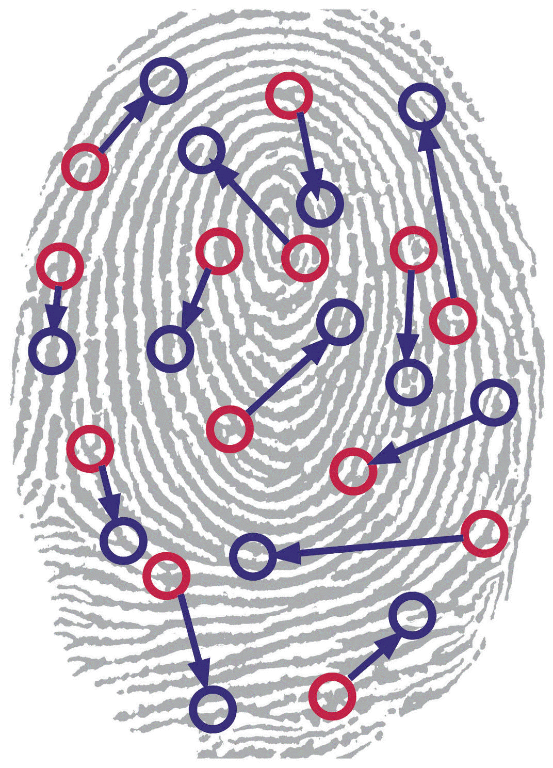
Authentication
▪▪ Proving identity can be done using:
Something you know
▪▪ Password
▪▪ Something you do
Something you have
▪▪ Physical object
▪▪ Value read from a device you have
Something you are
▪▪ Biometric reading

Slide 7
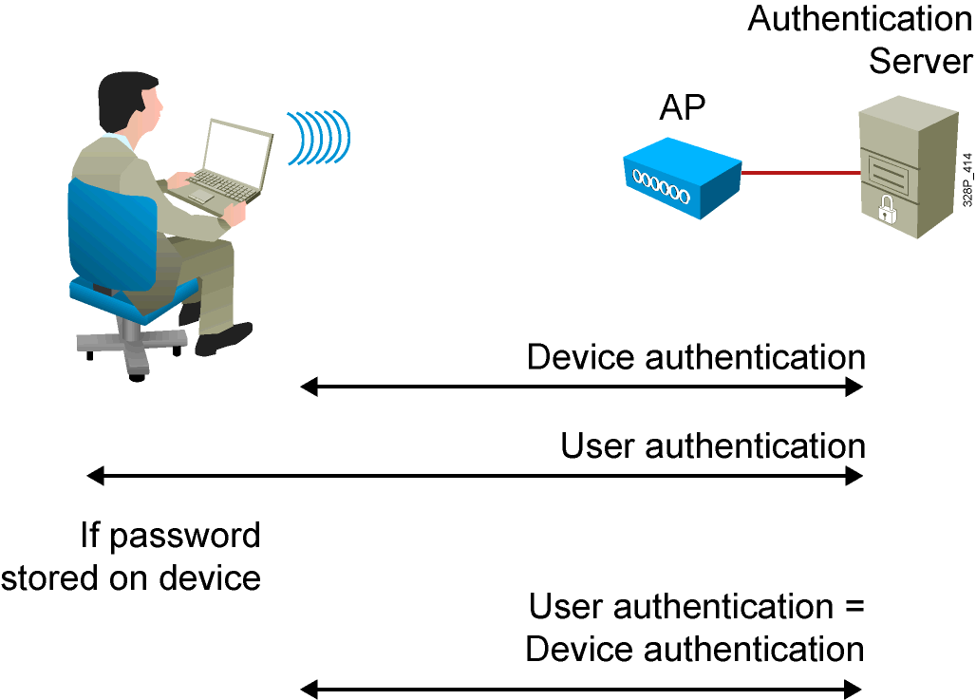
Authenticating Devices vs. Users

Slide 8
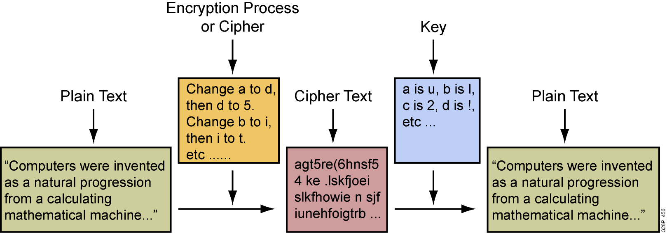
Encryption

Slide 9
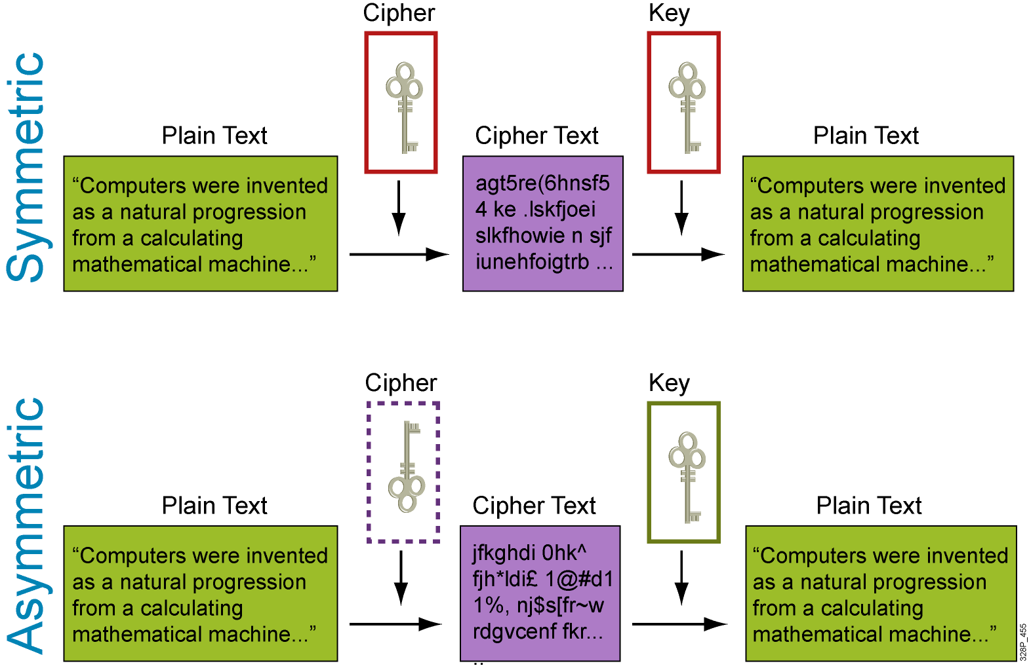
Symmetric and Asymmetric Encryption

Slide 10
Wireless Threats
▪▪ Rogue access points:
Usually default configuration
Any client on a rogue access point is a rogue client
▪▪ Ad hoc networks:
Open potential weaknesses
Occupy one of your channels
▪▪ Client misassociation - accessing the right SSID on a rogue AP
▪▪ Wireless attacks:
Management frames spoofing
Active attacks
Passive attacks

Slide 11
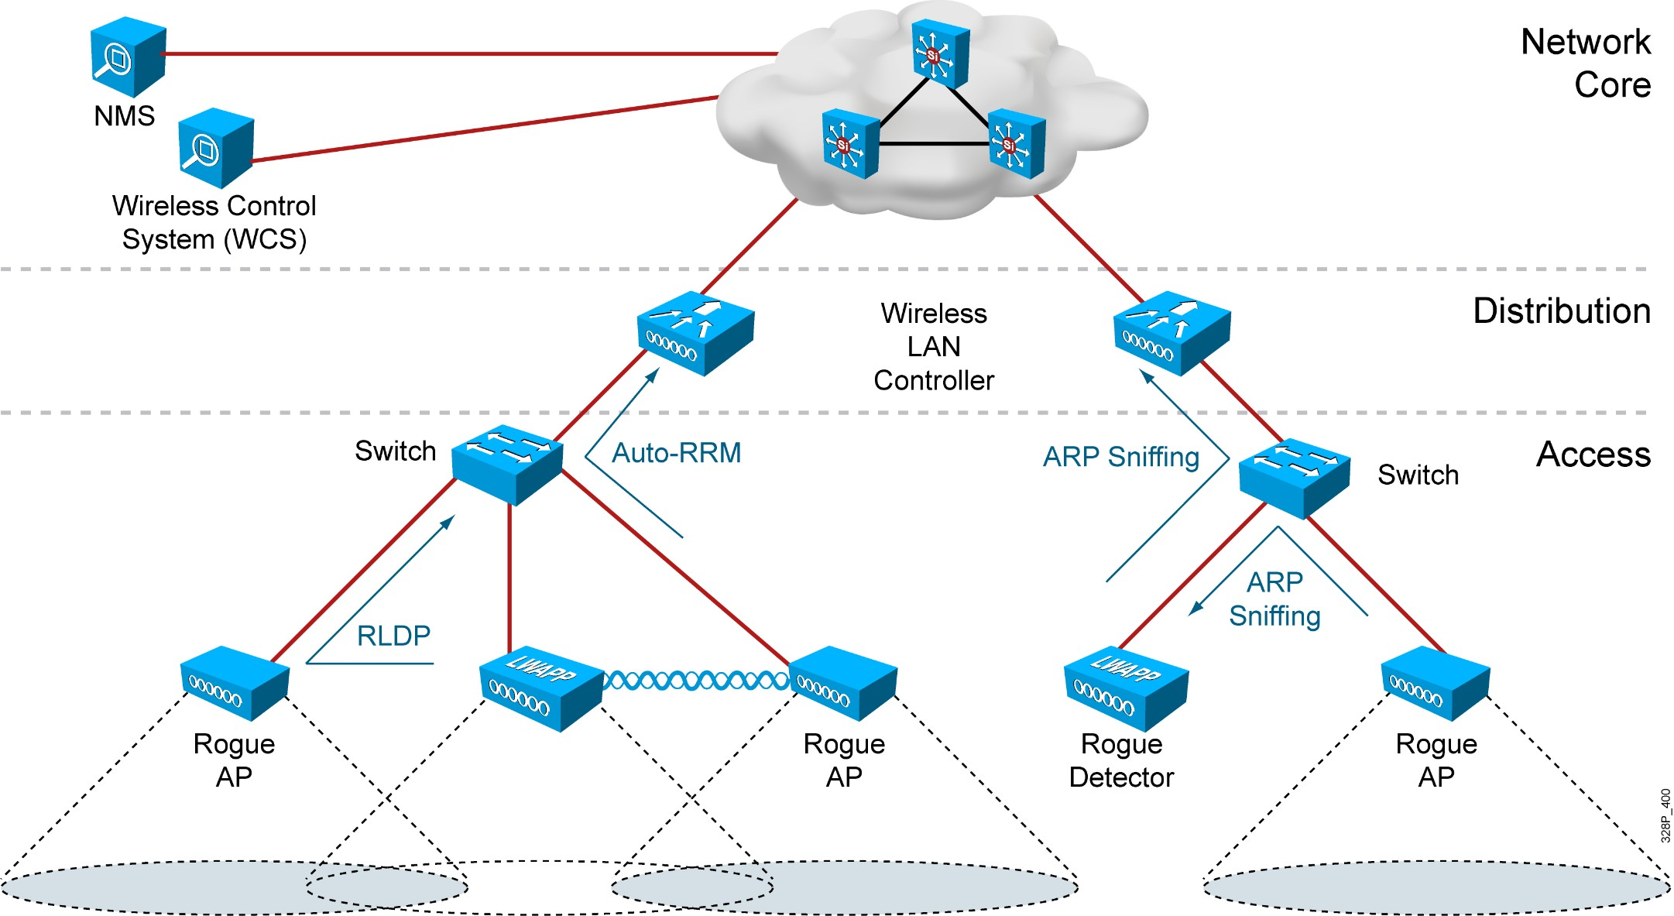
Wireless IDS

Slide 12
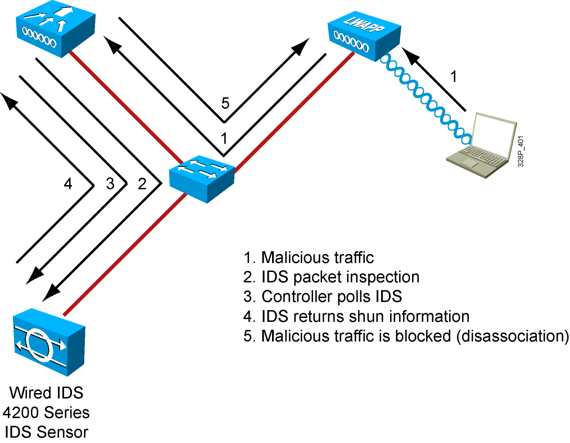
Wireless IPS

Slide 13
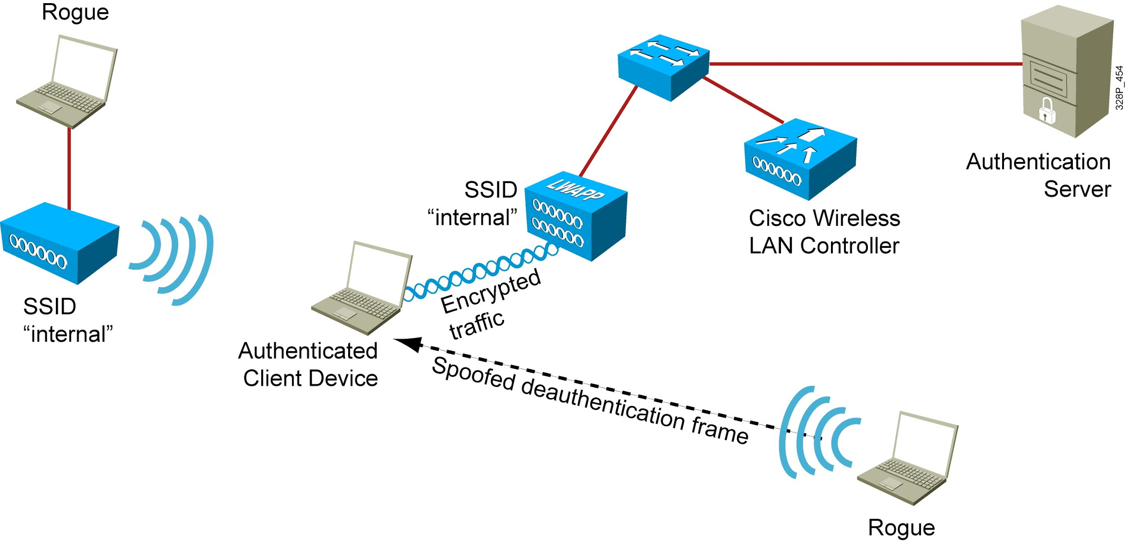
Management Frame Protection

Slide 14
Summary
▪▪ In wireless networks, authentication determines who accesses the network, and encryption protects data privacy.
▪▪ User authentication can be done using something you know, something you have, or something you are. The devices used to access the network can also be authenticated.
▪▪ In wireless networks, encryption is used to add privacy.
▪▪ Authentication or encryption keys can be common to a cell or unique to each user.
▪▪ Controllers can be linked to Cisco IDS to cut Layer 3-to-Layer 7 attackers completely from the Layer 2 wireless connection.
▪▪ In Cisco networks, Management Frame Protection can limit the impact of attacks based on management frames.

Slide 15
isco and/or its affiliates. All rights reserved.
Cisco Confidential

Slide 16

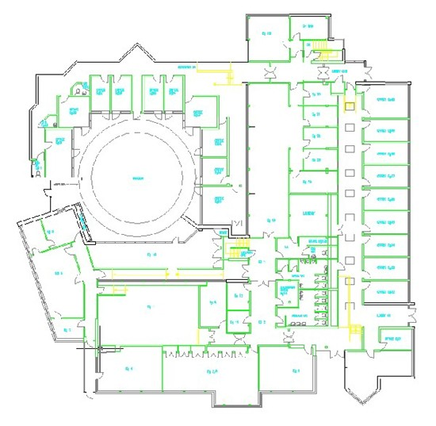
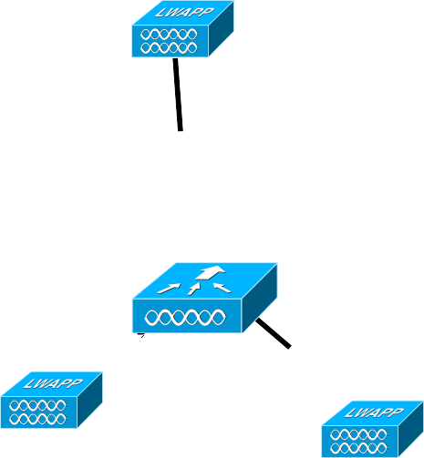
Why Are Wireless LANs Prone to Attack?
Physical Security
Wired Security
▪▪ Open air nature of RF
▪▪ Propagation Control is difficult
No physical barriers to intrusion
▪▪ Standard 802.11 protocol
Well-documented and understood
The most common attacks against WLAN networks are targeted at management frames
▪▪ Unlicensed
Easy access to inexpensive technology, for deployments and attack
Enterprise Network
Wireless Access Outside of Physical/Wired Boundaries

Slide 17
Need for WLAN Security
▪▪ Open, Pervasive nature of RF
Can’t control RF Propagation, don’t need physical access to launch attacks anymore
▪▪ Business impact of stolen data
Potential legal and financial implications (specially in retail, healthcare and government verticals)
▪▪ Innate design, per IEEE 802.11, was designed with basic security needs in mind – times have changed
Known vulnerabilities over time
WLANs are easy DoS targets: jamming, floods, man-in-the-middle attacks, and dictionary attacks…
No protection of 802.11 Management and Control frames, most solutions address 802.11 Data frames only
▪▪ Need to protect and authorize access to network services and resources

Slide 18
Security Risk Assessment
▪▪ Sensitive data
What is classified as Sensitive varies by organization
Determined at all levels of an organization what data must be protected from both a legal and business viewpoint
Appropriate data is protected with proper protection.
Intellectual property, trade secrets, identity information, financial information, health information, and employee and customer databases
Possibility that some data is too high a security risk
▪▪ Network services
Availability of a company's network, and such actions would cause damage to the company's productivity and affect sales.
Services : E-mail services, file servers, database services, directory services, Internet connectivity, Web-based applications, virus and intrusion detection services, and custom application services.

Slide 19
Security Policy and what it means
▪▪ Security Policy
An organization needs a security policy to define how to protect sensitive data and network services.
What to do if systems or policies fail..
▪▪ Network services
IT organization needs to work with the Security organization to help define the Security Policy and deploy network services inline with the Security Policy
▪▪ Client Capabilities
Understanding the capabilities of the network and more importantly the capabilities of the client endpoints will ensure a secure WLAN deployment able to meet the requirements of the business.

Slide 20
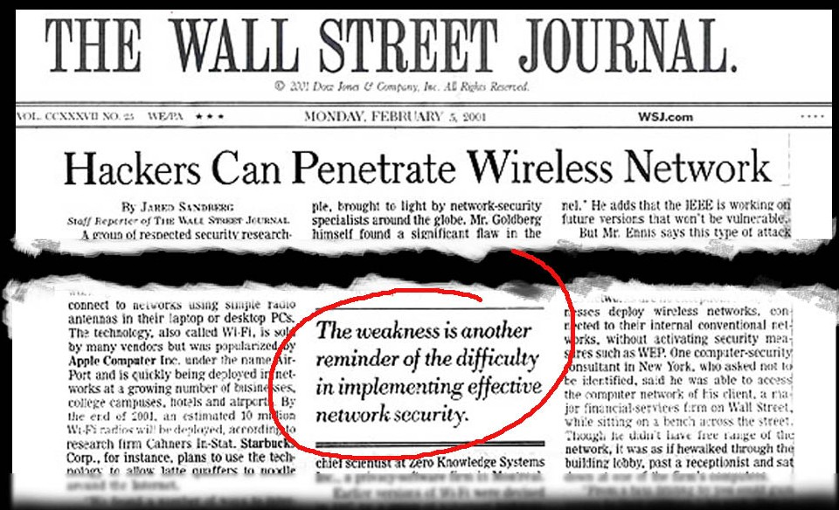
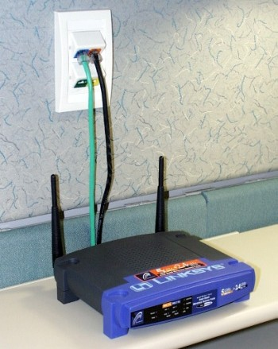

Why Is WLAN Security Important?
Hackers/Criminal
Vulnerabilities:
Employees
“War Driving”
Lessons:
▪▪ Do not rely on basic WEP encryption; requirement for enterprise class security (WPA, EAP/802.1x protocols, Wireless IDS, VLANs/SSIDs, etc.)
▪▪ Employees often install WLAN equipment on their own (compromises security of your entire network)
▪▪ Business impact due to stolen data: Potential financial and legal consequences (laws to protect data confidentiality; example: healthcare, retail, financial, government)

Slide 21

WLAN Security “Visibility”
▪▪ Prevalence of technology
PWLAN (Public Wireless LAN) and other public 802.11 networks
▪▪ Other security fears—identity theft, phishing, etc. “Hackers target Xbox Live players”, Feb 20, 2009 http://news.bbc.co.uk/2/hi/technology/7888369.stm “Crime to boom as downturn blooms” Dec 30, 2008 http://news.bbc.co.uk/2/hi/technology/7797946.stm Public availability of tools
Aircrack—WEP key exploit coWPAtty—WPA-PSK exploit
Kismac—MAC-based implementation of Kismet http://www.darknet.org.uk/2006/04/top-15-securityhacking-tools-utilities

Slide 22


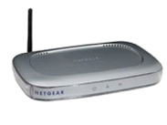



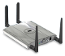
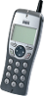
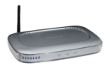


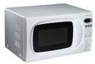

Wireless Security Threats
Classifying the attack types
On-Wire Attacks
Over-the-Air Attacks
Ad-hoc Wireless Bridge
Evil Twin/Honeypot AP
Reconnaissance
HACKER
HACKER’S AP
HACKER
Client-to-client backdoor access
Connection to malicious AP
Seeking network vulnerabilities
Rogue Access Points
Denial of Service
Cracking Tools
HACKER
HACKER
DENIAL OF SERVICE
Backdoor network access
Service disruption
Sniffing and eavesdropping
Non-802.11 Attacks
Backdoor access
BLUETOOTH AP
Service disruption
MICROWAVE
BLUETOOTH
RF-JAMMERS
RADAR

Slide 23
WLAN Security Vulnerabilities and Threats
Examples of Existing Vulnerabilities and Threats
▪▪ WLAN sniffing/war driving
▪▪ Encryption vulnerabilities: WEP
▪▪ Denial of Service (DoS) attacks: using 802.11 de-authentication/disassociation frames,
RF jamming, etc.
▪▪ Authentication vulnerabilities: dictionary attacks, MITM attacks
▪▪ Address spoofing: MAC-address spoofing and
IP address spoofing (both hostile/outsider attacks as well as insider attacks)

Slide 24

An Example:
How Does a Wireless Exploit Take Place?
▪▪ Probe response “listening” (to get SSID)
▪▪ Passive WEP key sniffing
▪▪ Initial phases of WLAN security exploit
Discovery of WLAN networks by monitoring for probe/probe responses
Collection of sufficient encrypted packets, offline processing and attempt to calculate WEP key

Slide 25
An Example:
How Does a Wireless Exploit Take Place?
Active De-Auth to Induce Clients to Probe (Reduces Time to Overcome SSID “Cloaking”
▪▪ For example, “Kismac” tool: offers a “suite” of exploit tools with a easy-to-use GUI
▪▪ http://www.ethicalhack.org/videos.php
▪▪ Authentication exploits can then be undertaken, once a client has been provoked to re-authenticate
▪▪ Or, if client may be induced to negotiate unauthenticated/unencrypted connection,
a direct exploit on client may be undertaken

Slide 26
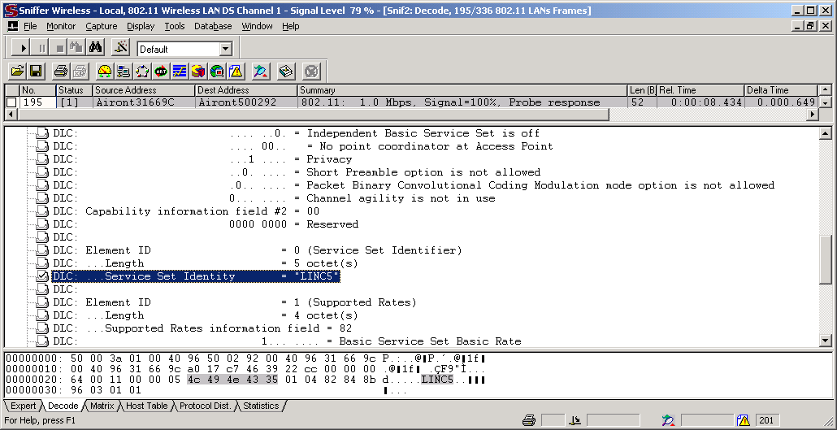
WLAN Sniffing and SSID Broadcasting
 | The Simplest Type of WLAN Exploit ▪▪ However, given the “open” characteristics of 802.11 association behavior, one that is not easily fixed ▪▪ Disabling SSID “broadcast” simply overcomes passive sniffing; SSID
 | is easily discovered by observing probe responses from clients ▪▪ Thus, SSID “cloaking” shouldn’t be considered a security mechanism

Slide 27
802.11 WEP Vulnerabilities
▪▪ 802.11 Static-WEP is flawed: encryption passive attacks
RC4 Key Scheduling algorithm uses 24-bit Initialization Vector (IV) and does not rotate encryption keys
Practical tools that have implemented FMS attack (example: AirSnort) can uncover the WEP key after capturing 1,000,000 packets
This is about ~ 17 minutes to compromise the WEP key in a busy network;
this attack is passive and all the attack tool needs to do is “listen” to the WLAN network (i.e., sniff WLAN packets)
▪▪ 802.11 Static-WEP is flawed: encryption active attacks
Does not protect the WLAN user data integrity
Several forms of attacks possible: Replay attacks, bit-flipping attacks, etc.
▪▪ 802.11 Static-WEP shared key authentication is flawed
AP challenges (plaintext challenge) the WLAN user to ensure possession of valid encryption key
Attacker can obtain key stream ➔➔ plaintext challenge XOR ciphertext = Key Stream

Slide 28
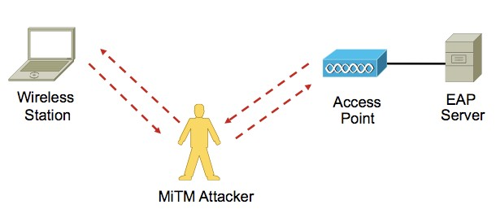
Wireless: Man in the Middle Attacks
▪▪ A MiTM is when an attacker poses as the network to the clients and as a client to the actual network
Attacker must first force client off of intended network in order to lure wireless station to associate to “rogue network”
The attacker gains security credentials by intercepting user traffic
▪▪ Very easy to do with: MAC Address Spoofing Rogue Device Setup DoS Attacks
Easier Sniffing, and war-driving

Slide 29
Wireless: Rogue Devices
▪▪ What is a Rogue?
Any device that’s sharing your spectrum, but not managed by you
Majority of rogues are setup by insiders (low cost, convenience, ignorance)
▪▪ When is a Rogue dangerous?
When setup to use the same ESSID as your network (honeypot) When it’s detected to be on the wired network too
Ad-hoc rogues are arguably a big threat, too!
Setup by an outsider, most times, with malicious intent
▪▪ What needs to be done?
Classify Detect
Reporting, if needed
Track (over-the-air, and on-the-wire) and Mitigate (Shutdown, Contain, etc)

Slide 30

Rogue AP Vulnerability:
Both Internal and External Sources
Frustrated insider
▪▪ User that installs wireless AP in order to benefit from increased efficiency and convenience it offers
▪▪ Common because of wide availability of low cost APs
▪▪ Usually ignorant of AP security configuration, default configuration most common
Malicious hacker
▪▪ Penetrates physical security specifically to install a rogue AP
▪▪ Can customize AP to hide it from detection tools
▪▪ Hard to detect—more effective to prevent via 802.1x and physical security
▪▪ More likely to install LINUX box than an AP
Most Rogue APs
James from Accounting
Less likely

Slide 31
What Is a Dictionary Attack Tool?
▪▪ What is a dictionary?
Contains variations of passwords
Weak passwords can be cracked using standard dictionaries (found easily in various Internet discussion forums and web sites)
▪▪ Success factors for this tool depend on:
Variation of the user’s password must be found in the dictionary used by the attacker Attacker’s experience and knowledge in generating dictionaries
Password strength
A weak six character password will be easily compromised compared to a strong ten letter password
Attacker’s dictionary strength determines whether the password can be compromised

Slide 32
MAC Address Spoofing
▪▪ As with wired networks, MAC address and IP address spoofing are possible, if not easy, in Wireless Networks
▪▪ Outsider (hostile) attack scenario
Does not know key/encryption policy
IP Address spoofing is not possible if Encryption is turned on (DHCP messages are encrypted between the client and the AP)
MAC Address spoofing alone (i.e., without IP Address spoofing) may not buy much if encryption is turned on
▪▪ Insider attack scenario
Seeking to obtain users’ secure info
MAC address and IP Address spoofing will not succeed if EAP/ 802.1x authentication is used (unique encryption key is derived per user (i.e., per MAC address))
Authorized Client
Sniff Client MAC Addr and IP Address
Acce
Poin
Inject Packets into the WLAN Network Using Client’s MAC/ IP Address

Slide 33
Wireless Sniffing: Good and Bad
▪▪ First – Sniffing, or capturing packets over the air, is an extremely useful troubleshooting methodology
▪▪ Sniffing, in the old days was reliant on very specific cards and drivers
▪▪ Very easy to find support for most cards and drivers today
▪▪ Cost (if you like to pay for it) of such software is negligible (or, just use free/ opensource software)
▪▪ Provides an insight (with physical proximity) into the network, services, and devices which comes in handy when performing network reconnaissance

Slide 34
WLAN Security
Denial of Service Attacks
▪▪ RF Jamming
–Any intentional or un-intentional RF transmitter in the same frequency can adversely affect the WLAN
▪▪ DoS using 802.11 Management frames (MPF can help mitigate)
–Management frames are not authenticated today
–Trivial to fake the source of a management frame
–De-Authentication floods are probably the most worrisome
▪▪ Misuse of Spectrum (CSMA/CA – Egalitarian Access!)
–“Silencing” the network with RTS/CTS floods, Big-NAV Attacks
▪▪ 802.1X Authentication floods and Dictionary attacks
–Overloading the system with unnecessary processing
–Legacy implementations are prone to dictionary attacks, in addition to other algorithm-based attacks

Slide 35
Authentication Vulnerabilities
▪▪ Management frames are not authenticated !
▪▪ Dictionary attacks
On-line (active) attacks: active attack to compromise passwords or pass-phrases
Off-line attacks: passive attack to compromise passwords or pass- phrases
▪▪ MITM attacks
Active attacks: an attacker attempts to insert himself in the middle of authentication sequence
▪▪ Can be employed in 802.1X as well as PSK environments
Multiple known WEP weaknesses, and many exploits out there

Slide 36
Exploits Using 802.11 as a Launchpad
▪▪ Standard Layer 2 exploits, e.g., Dsniff, Nmap
▪▪ Penetration test—server and service vulnerabilities: Metasploit project—open source RPC injector http://metasploit.com Immunity CANVAS
Core security technology impact
▪▪ Application security—exploit/malware
▪▪ Specific examples that have been launched:
Installation of various viruses, worms, and other malware, thereby complicating detection— Security Conference, Canfield University, UK
Simple sniffing of unencrypted user ID, passwords, account nos., etc.—Wi-Fi hotspots

Slide 37
WLAN Security Vulnerabilities and Threats Summary
▪▪ Wireless LANs have become easy targets for both “traditional” network exploits, as well as criminal element
▪▪ Passive SSID probe sniffing and WEP key attacks are just the first stage in WLAN exploits
▪▪ More sophisticated WLAN exploits are likely to employ management frames, as there is currently
no encryption capable for these 802.11 media management packets
▪▪ If an attacker can gain access to a WLAN, it is possible to launch a variety of higher-layer exploits over this media

Slide 38
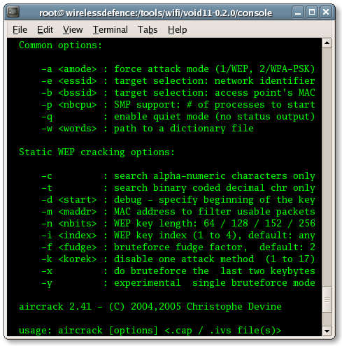
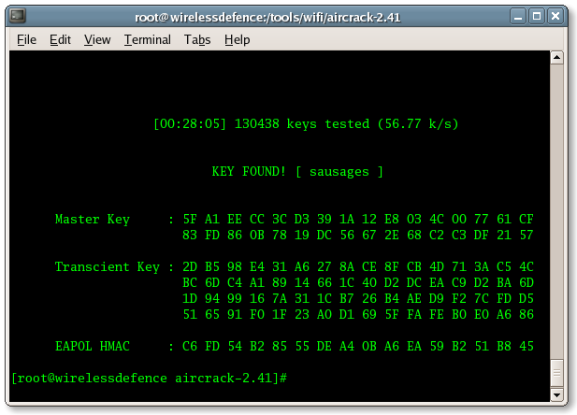
Quick Look: Common WLAN Exploits/Tools
▪▪ Remote-Exploit/Backtrack/Auditor
▪▪ Aircrack, WEPcrack, etc
▪▪ coWPAtty
▪▪ Kismet
▪▪ NetStumbler, Hotspotter, etc
▪▪ AirSnort
▪▪ Sniffing tools: OmniPeek, Wireshark
▪▪ dsniff, nmap
▪▪ wellenreiter
▪▪ asleap

Slide 39



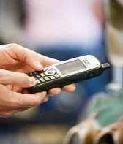


Over-the-Air Attack Techniques and Tools
Network Profiling and Reconnaissance
▪▪Honeypot AP
▪▪Kismet
▪▪Wellenreiter
▪▪Excessive device error
▪▪Excessive multicast/broadcast
▪▪Netstumbler
Authentication and Encryption Cracking
▪▪Dictionary attacks
▪▪ASLEAP
▪▪EAP-based attacks
▪▪CoWPAtty
▪▪Chop-Chop
▪▪Airckrack
▪▪Airsnort
▪▪PSPF violation
▪▪WEP Attack
▪▪Illegal frame types
▪▪Excessive association retries
▪▪Excessive auth retries
▪▪LEAPCracker
▪▪AirSnarf
▪▪Hotspotter
▪▪WEPCrack
Man-in-the-Middle
▪▪MAC/IP Spoofing
▪▪Evil Twin AP
▪▪ARP Request Replay Attack
▪▪Fake DHCP server
▪▪Pre-standard APs (a,b,g,n)
▪▪Fake AP
Denial of Service
▪▪Malformed 802.11 frames
▪▪EAPOL attacks
▪▪Probe-response
▪▪Resource management
▪▪RF Jamming
▪▪Michael
▪▪Queensland
▪▪Virtual carrier
▪▪Big NAV
▪▪Power-save attacks
▪▪Microwave interference
▪▪Bluetooth interference
▪▪Radar interference
▪▪Other non-802.11 interference
▪▪Device error-rate exceeded
▪▪Interfering APs
▪▪Co-channel interference
▪▪VoWLAN-based attacks
▪▪Excessive roaming
▪▪FATA-Jack, AirJack
▪▪Fragmentation attacks
▪▪Excessive authentication
▪▪De-auth attacks
▪▪Association attacks
▪▪CTS attacks
▪▪RTS attacks
▪▪Excessive device bandwidth

Slide 40
isco and/or its affiliates. All rights reserved.
Cisco Confidential

Slide 41






Cisco’s Attack Detection Mechanisms
Base IDS Adaptive wIPS
Built-in to Controller Software
Requires MSE
Uses Local and Monitor Mode APs
Uses wIPS Monitor Mode and/or Local APs

Slide 42







Cisco Wired IPS Integration
Unified Intrusion Prevention
Business Challenge
Mitigate Network Misuse, Hacking and Malware from WLAN Clients
Client Shun
▪▪ Inspects traffic flow for harmful applications and blocks wireless client connections
▪▪ Layer 3-7 Deep Packet Inspection
▪▪ Eliminates risk of contamination from wireless clients
▪▪ Zero-day response to viruses, malware and suspect signatures
L2 IDS
Malicious Traffic
L3-7 IDS
Enterprise Intranet
Cisco ASA w/ IPS
http://www.cisco.com/en/US/tech/tk722/tk809/technologies_configuration_example09186a008080dc8c.shtml

Slide 43








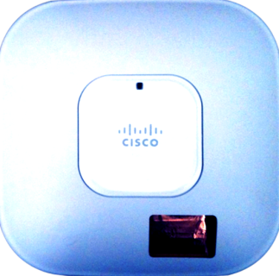


















What is CleanAir?
Detect and Classify
97
Uniquely identify and track multiple interferers
Detects security-risk interferers like RF Jammers and Video Camera.
Assess unique impact to Wi-Fi performance
Monitor AirQuality
100
63
90
20
35
High-resolution interference detection and classification logic built-in to Cisco’s 802.11n Wi-Fi chip design. Inline operation with no CPU or performance impact.
Cisco CleanAir
43

Slide 44
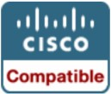

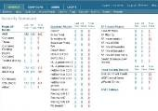

Management Frame Protection
Concept
Problem
Solution
▪▪ Wireless management frames are not authenticated, encrypted, or signed
▪▪ A common vector for exploits
▪▪ Insert a signature (Message Integrity Code/MIC) into the management frames
▪▪ Clients and APs use MIC to validate authenticity of management frame
▪▪ APs can instantly identify rogue/ exploited management frames
CCXv5
Infrastructure MFP Protected
AP Beacons | Probe Requests/ Probe Responses
Associations/Re-associations | Disassociations
Authentications/ De-authentications | Action Management Frames
Client MFP Protected

Slide 45





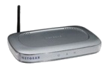


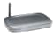
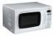

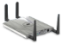
WLAN Security
Vulnerabilities and Threats
On-Wire Attacks
Over-the-Air Attacks
Ad-hoc Wireless Bridge _{Evil Twin/Honeypot AP} ^{Reconnaissance}
^{HACKER HACKER’S} HACKER AP
Client-to-client backdoor access Connection to malicious AP Seeking network vulnerabilities
Rogue Access Points Denial of Service Cracking Tools
_{HACKER} HACKER
DENIAL OF SERVICE
Backdoor network access ^{Service disruption} Sniffing and eavesdropping
Cisco wIPS Detects These Attacks
Non-802.11 Attacks
Backdoor access
BLUETOOTH AP ^{Service disruption} MICROWAVE BLUETOOTH RF-JAMMERS RADAR
Cisco CleanAir Detects These Attacks

Slide 46

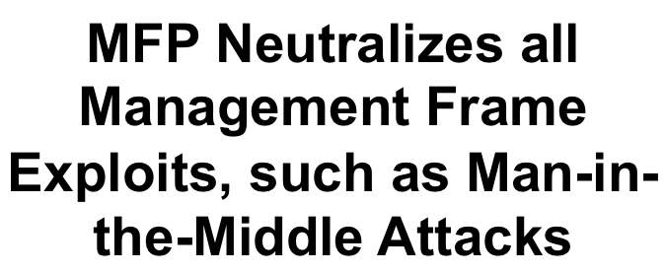


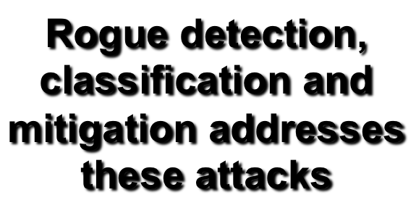


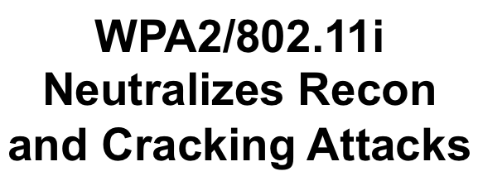


WLAN Security
Vulnerabilities and Threats
On-Wire Attacks
Over-the-Air Attacks
Ad-hoc Wireless Bridge _{Evil Twin/Honeypot AP} ^{Reconnaissance}
^{HACKER HACKER’S} HACKER AP
Client-to-client backdoor access Connection to malicious AP Seeking network vulnerabilities
Rogue Access Points Denial of Service Cracking Tools
_{HACKER} HACKER
DENIAL OF SERVICE
Backdoor network access ^{Service disruption} Sniffing and eavesdropping
MFP Neutralizes all Management Frame Exploits, such as Man-in- the-Middle Attacks
Rogue detection, classification and
WPA2/802.11i
Cisco wIP
S Detects Thes
e Attacks
mitigation addresses
Neutralizes Recon
these attacks
and Cracking Attacks
Non-802.11 Attacks
Backdoor access
BLUETOOTH AP ^{Service disruption} MICROWAVE BLUETOOTH RF-JAMMERS RADAR
Cisco CleanAir Detects These Attacks

Slide 47

isco and/or its affiliates. All rights reserved.
Cisco Confidential

Slide 48
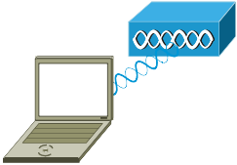
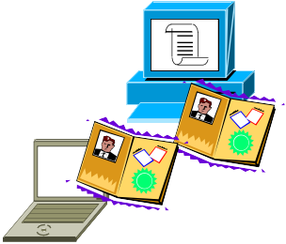


802.11 Security Fundamentals: Setting up a secure 802.11 link
Authentication
▪▪ Enforce strong, mutual authentication of client & server
▪▪ Recommendation is 802.1X/EAP
▪▪ 802.1X blocks user access until authentication successful
Association
▪▪ Establish a virtual port for the link
Encryption
▪▪ Enforce strong encryption to provide data privacy over the
802.11 link
– Recommendation is AES (WPA2) or TKIP (WPA)

Slide 49






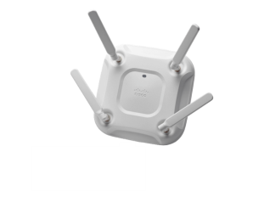
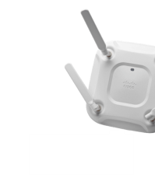





ecure or open SSID?
Secure SSID
Open SSID
A secure SSID cannot fall back to open.
Example: users not supporting 802.1X cannot fall back to web portal authentication on the same SSID as corporate users.
Pre-shared keys (PSK) and keys derived from 802.1X cannot co-exist on a secure SSID.
On both types of SSIDs you can combine multiple identity services if needed.
Examples: guest users going through posture assessment, employees going through MDM, employees going through web portal after device authentication, etc.

Slide 50



Authentication Evolution
MAC Address Authentication
WEP
802.1x /
Dynamic WEP
WPA/WPA2

Slide 51
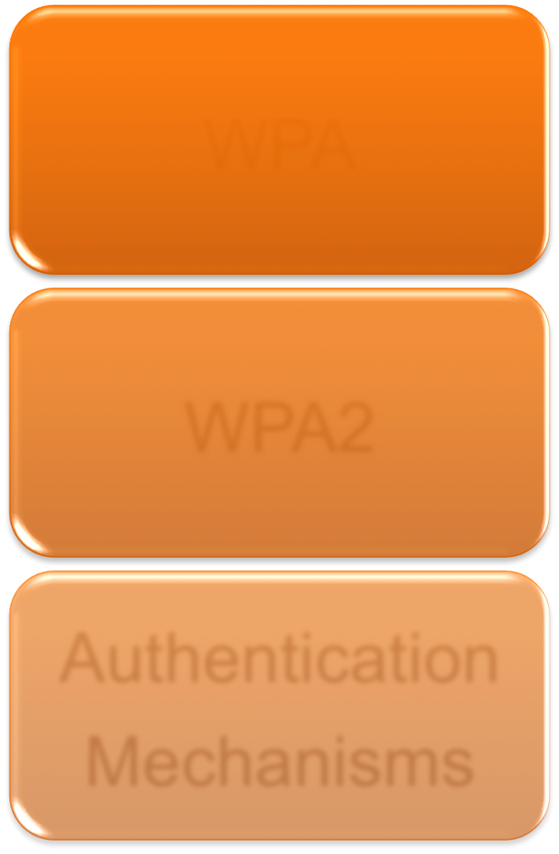

WPA/WPA2 Breakdown
WPA
A Snapshot of the 802.11i Standard
Commonly Used with TKIP Encryption
WPA2
Final Version of 802.11i
Commonly Used with AES Encryption
Authentication Mechanisms
Personal (PSK) – Home Use
Enterprise (802.1x/EAP) – Office Use

Slide 52
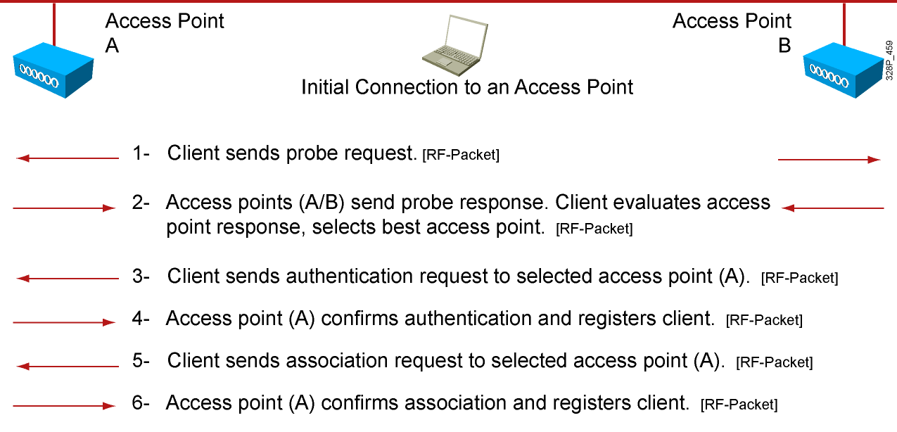
Authentication: Open

Slide 53
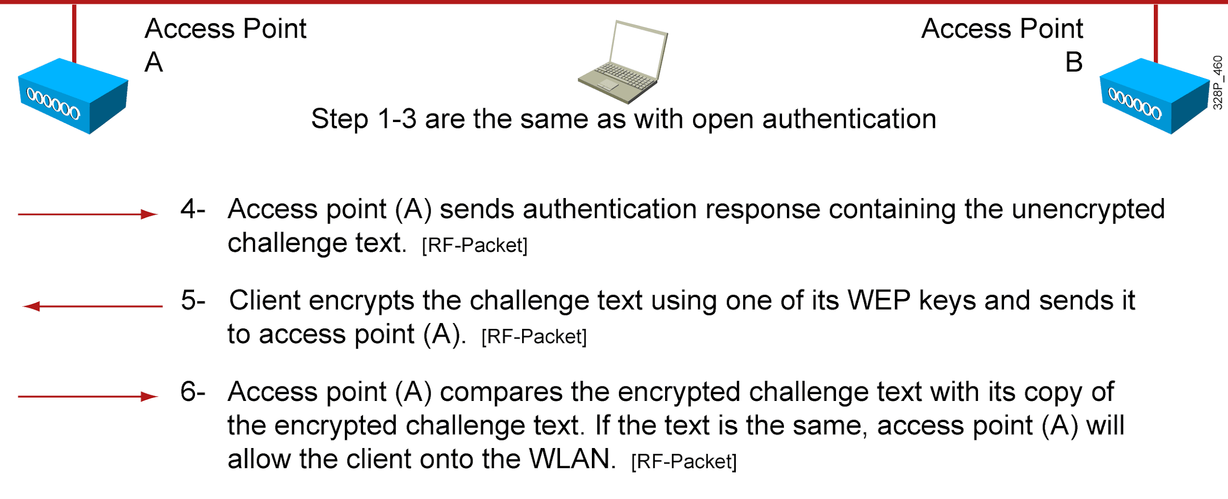
Authentication: PSK (WEP)

Slide 54
Authentication: PSK (WEP) (Cont.)
▪▪ WLAN security protocol defined in the 802.11 specification:
Operates at Layer 2 and does not offer end-to-end security
▪▪ Uses key plus initialization vector:
Initialization vector is a random number generated through the WEP algorithm
Key and initialization vector are used in encryption of the data
▪▪ Three user-specified key lengths:
40-bit key, combined with initialization vector to yield 64 bits
104-bit key, combined with initialization vector to yield 128 bits
128-bit key, combined with initialization vector to yield 152 bits
▪▪ Cisco wireless supports pre-shared key authentication:
Disabled by default

Slide 55
WEP Limitations
▪▪ No per-packet authentication or message integrity check
▪▪ Hackers can easily obtain challenge phrase and encrypted response:
Crack the WEP key
Correctly decrypt captured data traffic
▪▪ Weak encryption of data
▪▪ Repeating initialization vector can provide insight into cracking WEP key
▪▪ Each client and AP must be configured with matching WEP key
▪▪ Managing keys can be difficult in enterprise WLAN
▪▪ Less secure than using open Layer 2 association and then applying user authentication with dynamic encryption method

Slide 56
Wi-Fi Protected Access (WPA)
▪▪ WPA introduced in late 2003
▪▪ Pre-standard implementation of IEEE 802.11i WLAN security
▪▪ Addresses currently known security problems with WEP
▪▪ Allows software upgrade on already deployed 802.11 equipment to improve security
▪▪ Components of WPA
Authenticated key management using 802.1X: EAP authentication, and PSK authentication
Unicast and broadcast key management
Standardized TKIP per-packet keying and MIC protocol
Initialization vector space expansion: 48-bit initialization vectors
Migration mode—coexistence of WPA and non-WPA devices (optional implementation that is not required for WPA certification)

Slide 57
WPA Authentication Modes
Enterprise (802.1X Authentication) | Personal (PSK Authentication)
Authentication server required | Authentication server not required
RADIUS used for authentication and key distribution | Shared secret used for authentication
Centralized access control | Local access control
Encryption uses TKIP, AES optional | Encryption uses TKIP, AES optional

Slide 58
WPA2 and IEEE 802.11i
▪▪ 802.11i
Ratified in June 2004
Standardizes
▪▪ 802.1X for authentication
▪▪ AES to be used for encryption
▪▪ Key management
▪▪ WPA2
Supplement to WPA ”version 1”, which uses TKIP encryption
Provides for AES encryption to be used
Third-party testing and certification for WLAN device compatibility

Slide 59
IEEE 802.11i and AES Encryption
Uses AES encryption in lieu of RC4 encryption
▪▪ Specific AES implementation used in 802.11i is called
“AES Counter Mode with CBC-MAC authentication” (a.k.a. AES-CCMP)
▪▪ 128-bit, symmetric block cipher (versus RC4 stream cipher)
▪▪ AES cryptographically more robust than RC4 (and requires more computational power)
▪▪ AES is implemented in hardware

Slide 60
WPA/WPA2/802.11i Comparison
WPA | WPA2 | 802.11i
SOHO | Enterprise | Enterprise
802.1X authentication/PSK | 802.1X authentication/PSK | 802.1X authentication
128-bit RC4 w/ TKIP encryption cipher | 128-bit AES encryption cipher | 128-bit AES encryption cipher
Ad hoc not supported | Ad hoc not supported | Allows ad hoc
Test devices for compliance | Test devices for compliance | No test, specification

Slide 61
MAC Filtering
▪▪ Allows clients based on their MAC addresses
▪▪ The option is enabled on a per WLAN basis
▪▪ Controller checks for the presence of the client MAC address:
In a local database
If the address is not present, relays to a RADIUS server
▪▪ Local list contains 500 addresses, can be extended to 2000
The database is shared by local management users (including lobby ambassadors), net users (including guest users), MAC filter entries, and disabled clients.

Slide 62







Choosing an EAP Method
Security vs. Complexity
Authentication Server Support
Client Support
EAP
Type(s) Deployed
▪▪ Most clients such as Windows, Mac OSX, Apple iOS devices support EAP-TLS, PEAP (MS-CHAPv2).
Additional supplicants can add more EAP types (Cisco AnyConnect).
▪▪ Certain EAP types (TLS) can be more difficult to deploy than others depending on device type.

Slide 63




Authentication Best Practices:
WPA2-Enterprise
Strong Authentication
Extensible Authentication Protocol (EAP)
Outside Methods (Protective Tunnel):
PEAP
EAP-FAST
Inside Methods (Authentication Credentials):
EAP-MSCHAPv2
EAP-GTC
EAP-TLS (Certificate Based)
Strong Encryption
AES

Slide 64







EAP Authentication Types
Tunneling-Based
EAP-
Certificate- Based
Inner Methods
PEAP
EAP- TTLS
EAP-TLS
EAP-GTC
EAP-MSCHAPv2
EAP- FAST
▪▪ Tunnel-based - Common deployments use a tunneling protocol (EAP-PEAP) combined with an inner EAP type such as EAP- MSCHAPv2.
This provides security for the inner EAP type which may be vulnerable by itself.
▪▪ Certificate-based – For more security EAP-TLS provides mutual authentication of both the server and client.

Slide 65
EAP Methods Comparison
 | EAP-TLS | PEAP | EAP-FAST
Fast Secure Roaming (CCKM) | Yes | Yes | Yes
Local WLC Authentication | Yes | Yes | Yes
OTP (One Time Password) Support | No | Yes | Yes
Server Certificates | Yes | Yes | No
Client Certificates | Yes | No | No
PAC (Protected Access Credentials)* | No | No | Yes
Deployment Complexity | High | Medium | Low
* PACs can be provisioned anonymously for minimal complexity.

Slide 66



Encryption Evolution
WEP
(RC4)
TKIP
(RC4 and MIC)
AES
(CCMP)

Slide 67


Encryption Best Practices:
TKIP and AES
TKIP (Temporal Key Integrity Protocol)
Use only for legacy clients without AES support
Often a software update for WEP clients
Can be run in conjunction with AES (mixed- mode)
Is being discontinued by the WiFi Alliance for certification.
AES (Advanced Encryption Standard)
Requires hardware support (~2005 chipsets or later)
Achieves line-rate speeds
Only encryption standard supported for 802.11n data rates

Slide 68
The TKIP Vulnerability
▪▪ Once thought safe, TKIP encryption is cracked: http://www.pcworld.com/businesscenter/article/153396/ once_thought_safe_wpa_wifi_encryption_is_cracked.html
▪▪ Security researchers claim that they can crack the message integrity (MIC) key used in TKIP
▪▪ Recovery of MIC key facilitates packet forgeries, but only between AP and client
▪▪ Encryption key is *not* recovered, therefore data traffic cannot be read via this attack – this is not like the WEP crack of years back
▪▪ What is the Risk?
Common traffic types, such as ARP and DNS, can be replayed to client for very limited duration… at most 7 times

Slide 69
isco and/or its affiliates. All rights reserved.
Cisco Confidential

Slide 70
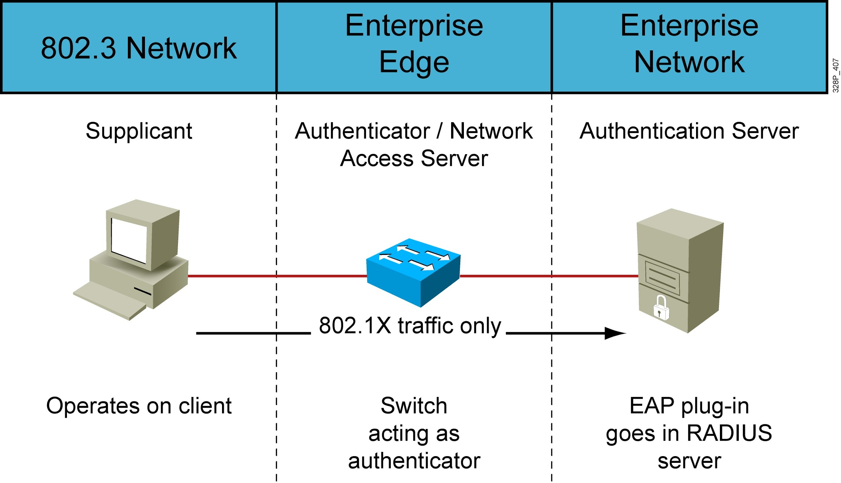

802.1x
WLC

Slide 71
802.1x Architecture
Credentials
Certificate
Username and Password
Microsoft/ Cisco/
Microsoft
TLS
Cisco ^{RSA}
EAP-Fast PEAP
Authentication
EAP
Session Key
WPA
WPA2
802.1x
Encryption
WEP
TKIP
AES

Slide 72
802.1x Identity Information Types
fferent types for different mobility use cases:
Username/Password Combination
EAP
Extensible Authentication Protocol
PEAP
Protected EAP
GTC
Generic Token Card
FAST
Flexible Authentication via Secure Tunneling TLS
Transport Layer Security
User authentication (also Machine Auth for Windows)
Active Directory/LDAP/RADIUS ID Stores
EAP types: PEAP-MSCHAPv2, PEAP-GTC, EAP-FAST
Two-Factor Authentication
Something you know, you have, you are
Mostly for user authentication
RSA SecurID and other token-based ID Systems
EAP types: PEAP-GTC, EAP-FAST/EAP-GTC
Digital Certificates
Signed/emitted by a public or private Certificate Authority
Can be used for user and/or device authentication
Microsoft AD Certificate Services, Entrust, Verisign, etc.
EAP types: EAP-TLS, EAP-FAST
© 2015 Cisco and/or its affiliates. All rights reserved.

Slide 73
Local EAP
▪▪ The following EAP methods are supported with local EAP:
LEAP
EAP-FAST (both username and password with PAC and certificates)
EAP-TLS
PEAP
▪▪ MAC authentication is also supported in addition to the above methods
▪▪ Local EAP authentication can be used if the Cisco WLC fails to reach the configured RADIUS servers
▪▪ Supports local users or LDAP users
▪▪ Requires WLAN configuration

Slide 74
LEAP
▪▪ Cisco WLAN security solution
▪▪ User authentication via user ID and password
▪▪ Single login using Windows NT/2000 Active Directory
▪▪ Dynamic WEP keys and mutual authentication
Key integrity protocol/message integrity recommended
▪▪ Simplified deployment and administration
▪▪ Supports multiple operating systems
Windows, Mac OS, Windows CE, DOS, and Linux
▪▪ Strong password policy recommended

Slide 75
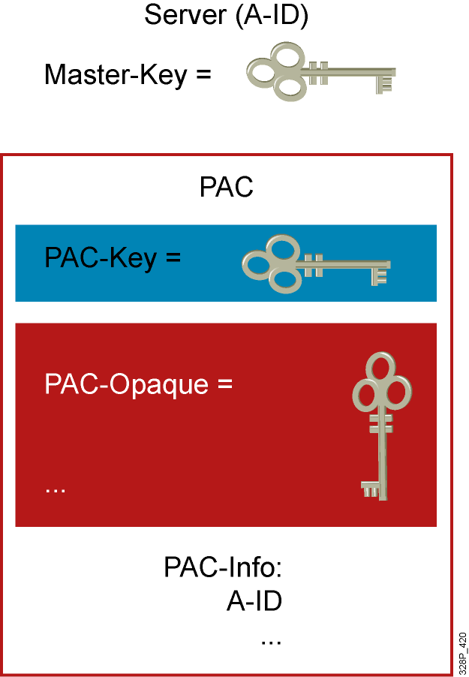
EAP-FAST
Considered in three phases:
▪▪ Protected Access Credentials (PAC) is generated in phase zero
(Dynamic PAC provisioning)
Unique shared credential used to mutually authenticate client and server
Associated with a specific user-ID and an Authority ID
Removes the need for PKI
▪▪ A secure tunnel is established in phase one
▪▪ Client is authenticated via the secure tunnel in phase two

Slide 76
EAP-TLS
Client support
▪▪ Windows 2000, XP, Vista and Windows CE (natively supported)
▪▪ Linux, Mac AirPort Extreme
▪▪ Each client requires a user certificate
Infrastructure requirements
▪▪ EAP-TLS-supported RADIUS server
▪▪ RADIUS server requires a server certificate
▪▪ Certificate Authority server (PKI Infrastructure)
Certificate management
▪▪ Both client and RADIUS server certificates to be managed

Slide 77
PEAP
▪▪ Hybrid authentication method
Server side authentication with TLS
Client side authentication with EAP authentication types
▪▪ EAP-GTC
▪▪ EAP-MSCHAPv2
▪▪ Clients do not require certificates
▪▪ RADIUS server requires a server certificate
RADIUS server self-issuing certificate capability
Purchase a server certificate per-server from public PKI entity
Setup a simple PKI server to issue server certificates
▪▪ Allows for one-way authentication types to be used
One-time passwords
Proxy to LDAP, Unix, Microsoft NT and Active Directory, Kerberos

Slide 78

CCX—Providing Security Alternatives/ Tools/Cross-Platform Compatibility
More Than Just Standards
CCX v1
802.1x authentication EAP-TLS and LEAP
Cisco pre-standard TKIP Client rogue reporting
CCX v3
WPA2 compliance
EAP-FAST
CCKM with EAP-FAST
AES encryption
CCX v5
MFP
Client policies/ reporting
CCX v2
▪▪ WPA compliance
▪▪ Fast roaming with CCKM
▪▪ PEAP
CCX v4
▪▪ CCKM with EAP-TLS, PEAP
▪▪ WIDS
▪▪ MBSSID
Cisco Systems, Inc. All rights reserved.
IUWNE v1

Slide 79
EAP Protocols: Feature Support
 | EAP-TLS | PEAP | LEAP | EAP-FAST
Single Sign-on | Yes | Yes | Yes | Yes
Login Scripts (MS DB) | Yes¹ | Yes¹ | Yes | Yes
Password Expiration (MS DB) | N/A | Yes | No | Yes
Client and OS Availability | Vista, XP, CE, and Others² | Vista, XP, CE, CCXv2 Clients³, and Others² | Cisco/CCXv1 or Above Clients and Others² | Cisco/CCXv3 Clients⁴ and Others²
MS DB Support | Yes | Yes | Yes | Yes
LDAP DB Support | Yes | Yes⁵ | No | Yes
OTP Support | No | Yes⁵ | No | Yes⁶
1 Windows OS supplicant requires machine authentication (machine accounts on Microsoft AD) 2 Greater operating system coverage is available from via CSSC and third party supplicants
PEAP/GTC is supported on CCXv2 clients and above
Cisco 350/CB20A clients support EAP-FAST on MSFT XP, 2000, and CE operating systems EAP-FAST supported on CB21AG/PI21AG clients with ADU v2.0 and CCXv3 clients
Supported by PEAP/GTC only
Supported with 3rd party supplicant
Cisco Systems, Inc. All rights reserved.
IUWNE v1

Slide 80
EAP Protocols: Feature Support
 | EAP-TLS | PEAP | LEAP | EAP-FAST
Off-Line Dictionary Attacks? | No | No | Yes¹ | No
Local Authentication | No | No | Yes | Yes
WPA Support | Yes | Yes | Yes | Yes
Application Specific Device (ASD) Support | No | No | Yes | Yes
Server Certificates? | Yes | Yes | No | No
Client Certificates? | Yes | No | No | No
Deployment Complexity | High | Medium | Low | Low
RADIUS Server Scalability Impact | High | High | Low | Low/Medium
1 Strong password policy mitigates dictionary attacks; please refer to: http://www.cisco.com/en/US/products/hw/wireless/ps430/prod_bulletin09186a00801cc901.html
Cisco Systems, Inc. All rights reserved.
IUWNE v1

Slide 81
Web Authentication
▪▪ This allows users to authenticate through a web interface
▪▪ Clients who attempt to access the WLAN using HTTP are automatically directed to a login page:
Login page is customizable for logos and text
Maximum simultaneous authentication requests using web authentication is 21
Maximum number of local web authentication users is 2048 (default 512)
▪▪ This is generally used for guest access
▪▪ The Login page on the controller is now fully customizable
Cisco Systems, Inc. All rights reserved.
IUWNE v1

Slide 82
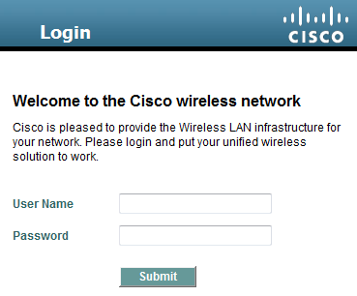
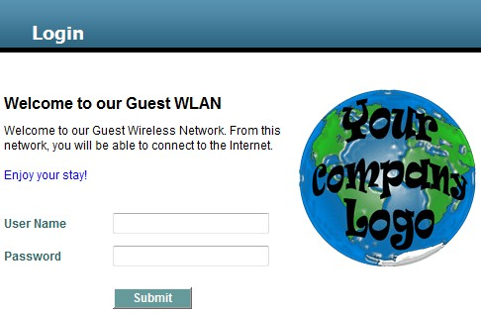
Web Authentication Page Configuration
Default Login Page
Customized Login Page (based on the previous slide’s configurations and a custom logo uploaded to the controller)
Cisco Systems, Inc. All rights reserved.
IUWNE v1

Slide 83
isco and/or its affiliates. All rights reserved.
Cisco Confidential

Slide 84
When Deploying Wireless Networks… Security should always be the primary concern.
eploy WLAN Security with a MINIMUM security configuration of WPA2/PSK and AES ncryption.
uest Wireless Access should adhere to the MINIMUM security configuration, but in the vent that is not feasible, use WebAuth with a Splash Page and disclaimers and a Login
nterprise WLAN Deployments should ALWAYS separate Guest Access and Corporate ccess with WVLANs and separate SSIDs.
WLANs are always being scanned… Be aware and monitor your RF environment.
isco and/or its affiliates. All rights reserved.
Cisco Confidential

Slide 85

he Cisco Learning Network
https://learningnetwork.cisco.com/welcome
CNA Wireless Study Materials
https://learningnetwork.cisco.com/community/certifications/wireless_ccna/wifund/study-material
CNA Wireless Certification Exam Topics
https://learningnetwork.cisco.com/community/certifications/wireless_ccna/wifund/exam-topics
isco and/or its affiliates. All rights reserved.
Cisco Confidential

Slide 86












an
Ac |  |  | a | d | e
nd |  | Wide |  |  |  | Ogen
et
rki
M

